Slide 1
Linear Discriminant Analysis
Dr. Alexander Victor
Alexander.victor@dbs.ie

Slide 2
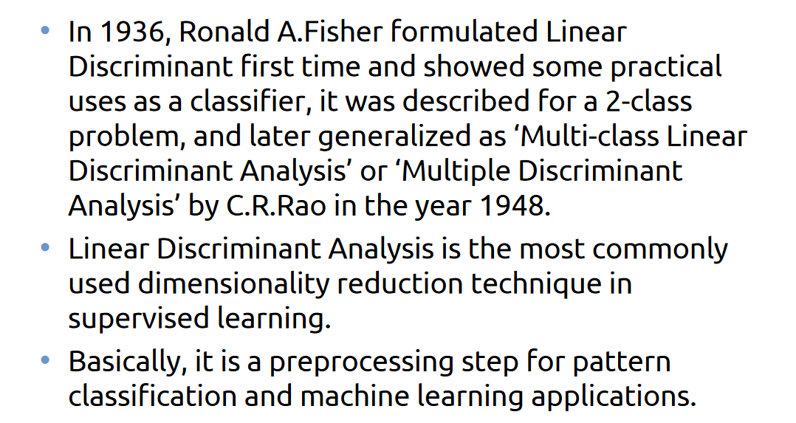
Introduction to LDA

Slide 3
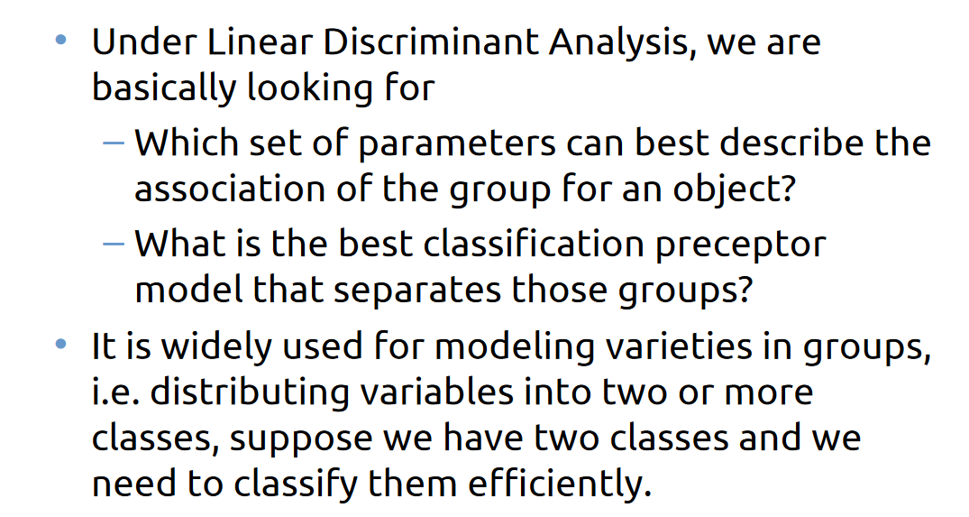
Introduction to LDA

Slide 4
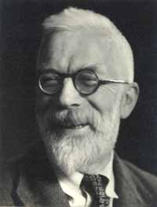
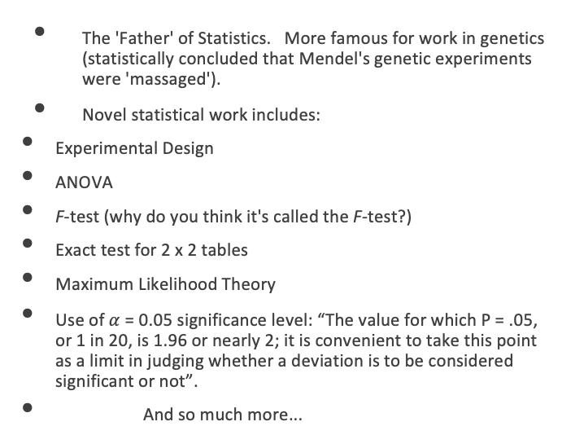
Inventor of LDA: R.A. Fisher
The 'Father' of Statistics. More famous for work in genetics (statistically concluded that Mendel's genetic experiments were 'massaged').
Novel statistical work includes:
Experimental Design
ANOVA
F-test (why do you think it's called the F-test?)
Exact test for 2 x 2 tables
Maximum Likelihood Theory
Use of $α$ = 0.05 significance level: “The value for which P = .05, or 1 in 20, is 1.96 or nearly 2; it is convenient to take this point as a limit in judging whether a deviation is to be considered significant or not”.
And so much more...

Slide 5
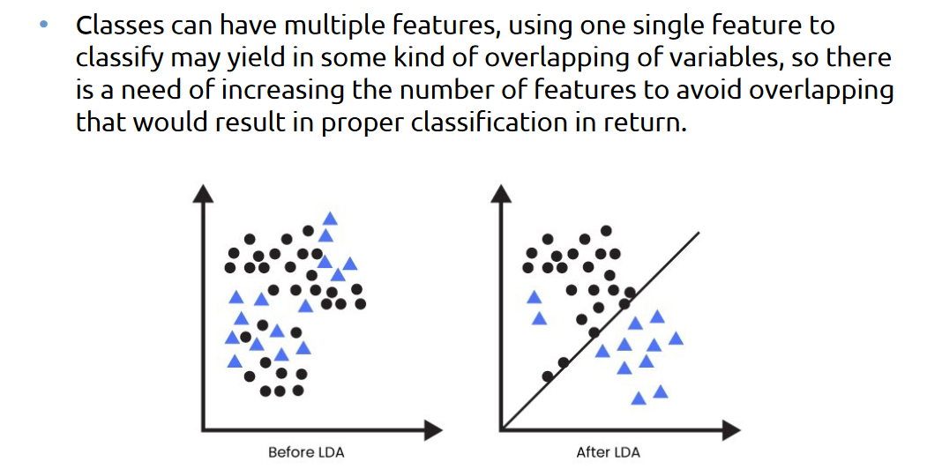
What LDA does?

Slide 6
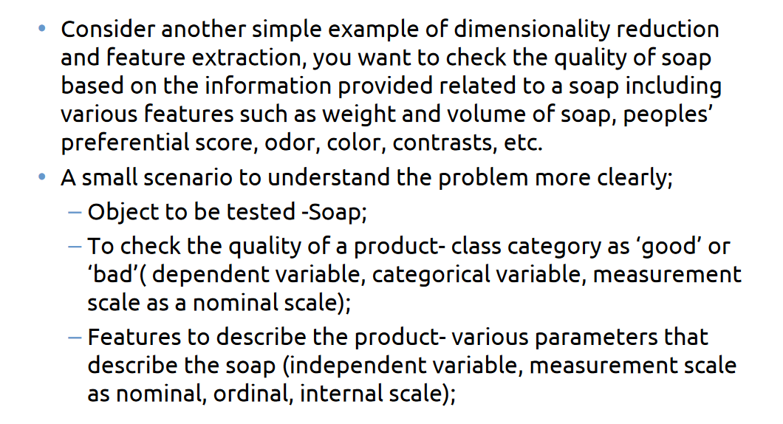
Example

Slide 7
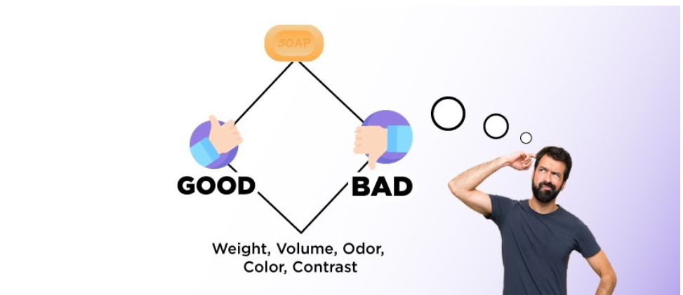
Example

Slide 8
Linear Discriminant Analysis (LDA)
Linear discriminant analysis (LDA) takes a different approach to classification than logistic regression.
Rather than attempting to model the conditional distribution of Y given X, P(Y = k|X = x), LDA models the distribution of the predictors X given the different categories that Y takes on, P(X = x|Y = k).
In order to flip these distributions around to model P(X = x|Y = k) an analyst uses Bayes' theorem.
In this setting with one feature (one X), Bayes' theorem can then be written as:
What does this mean?

Slide 9
LDA (cont.)
The left-hand side, P(Y = k|X = x), is called the posterior probability and gives the probability that the observation is in the k^{th} category given the feature, X, takes on a specific value, x.
The numerator on the right is conditional distribution of the feature within category k, f_{k}(x), times the prior probability that observation is in the k^{th} category.
The Bayes' classifier is then selected.
That is the observation assigned to the group for which the posterior probability is the largest.

Slide 10
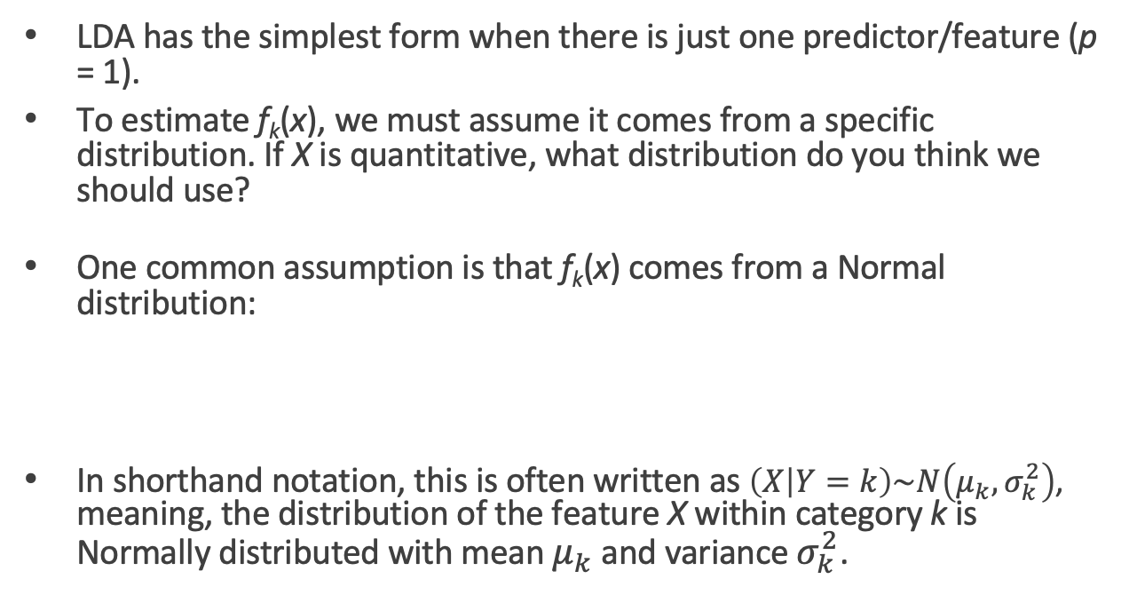
LDA for one predictor
LDA has the simplest form when there is just one predictor/feature (p = 1).
To estimate f_{k}(x), we must assume it comes from a specific distribution. If X is quantitative, what distribution do you think we should use?
One common assumption is that f_{k}(x) comes from a Normal distribution:
In shorthand notation, this is often written as $\left(X | Y=k\right)\sim N\left(μ_{k},σ_{k}^{2}\right)$, meaning, the distribution of the feature X within category k is Normally distributed with mean $μ_{k}$ and variance $σ_{k}^{2}$.

Slide 11
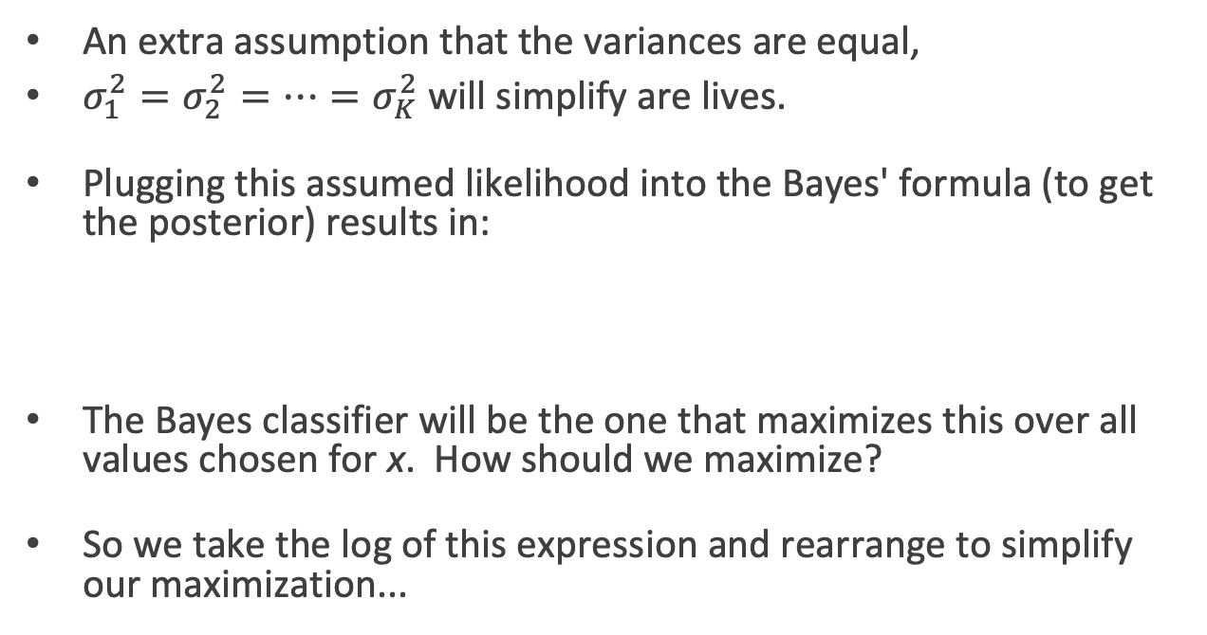
LDA for one predictor (cont.)
An extra assumption that the variances are equal,
$σ_{1}^{2}=σ_{2}^{2}=…=σ_{K}^{2}$ will simplify are lives.
Plugging this assumed likelihood into the Bayes' formula (to get the posterior) results in:
The Bayes classifier will be the one that maximizes this over all values chosen for x. How should we maximize?
So we take the log of this expression and rearrange to simplify our maximization...

Slide 12
LDA for one predictor (cont.)
So we maximize the following simplified expression:
How does this simplify if we have just two classes (K = 2) and if we set our prior probabilities to be equal?
This is equivalent to choosing a decision boundary for x for which
Intuitively, why does this expression make sense? What do we use in practice?

Slide 13
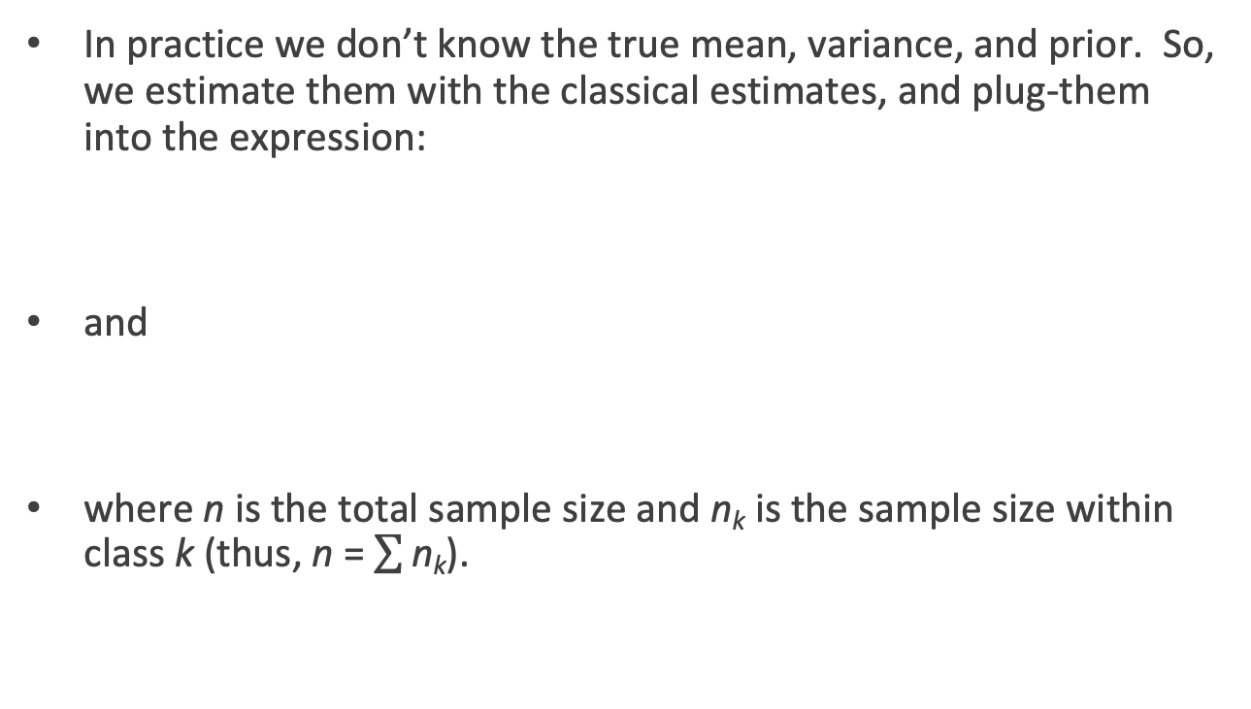
LDA for one predictor (cont.)
In practice we don’t know the true mean, variance, and prior. So, we estimate them with the classical estimates, and plug-them into the expression:
and
where n is the total sample size and n_{k} is the sample size within class k (thus, n = $\sum{\text{n}\text{k}}$).

Slide 14
LDA for one predictor (cont.)
This classifier works great if the classes are about equal in proportion but can easily be extended to unequal class sizes.
Instead of assuming all priors are equal, we instead set the priors to match the 'prevalence' in the data set:
Note: we can use a prior probability from knowledge of the subject as well; for example, if we expect the test set to have a different prevalence than the training set.

Slide 15
LDA for one predictor (cont.)
Plugging all these estimates back into the original logged maximization formula we get:
Thus this classifier is called the linear discriminant classifier: this discriminant function is a linear function of x.

Slide 16
Illustration of LDA when p = 1

Slide 17
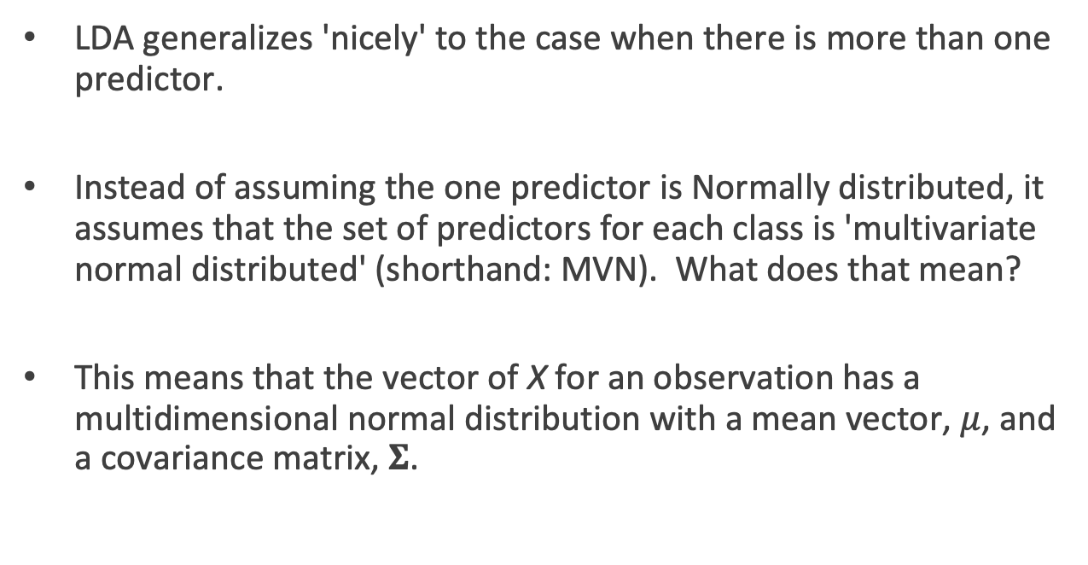
LDA when p > 1
LDA generalizes 'nicely' to the case when there is more than one predictor.
Instead of assuming the one predictor is Normally distributed, it assumes that the set of predictors for each class is 'multivariate normal distributed' (shorthand: MVN). What does that mean?
This means that the vector of X for an observation has a multidimensional normal distribution with a mean vector, $μ$, and a covariance matrix, $Σ$.

Slide 18
Multivariate Normal Distribution
Here is a visualization of the Multivariate Normal distribution with 2 variables:

Slide 19
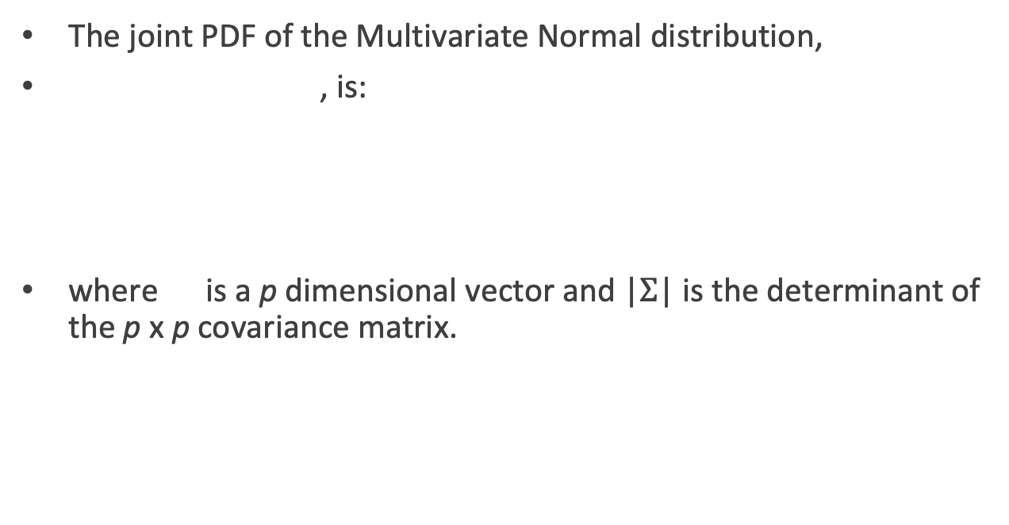
MVN Distribution
The joint PDF of the Multivariate Normal distribution,
, is:
where is a p dimensional vector and |$Σ$| is the determinant of the p x p covariance matrix.

Slide 20
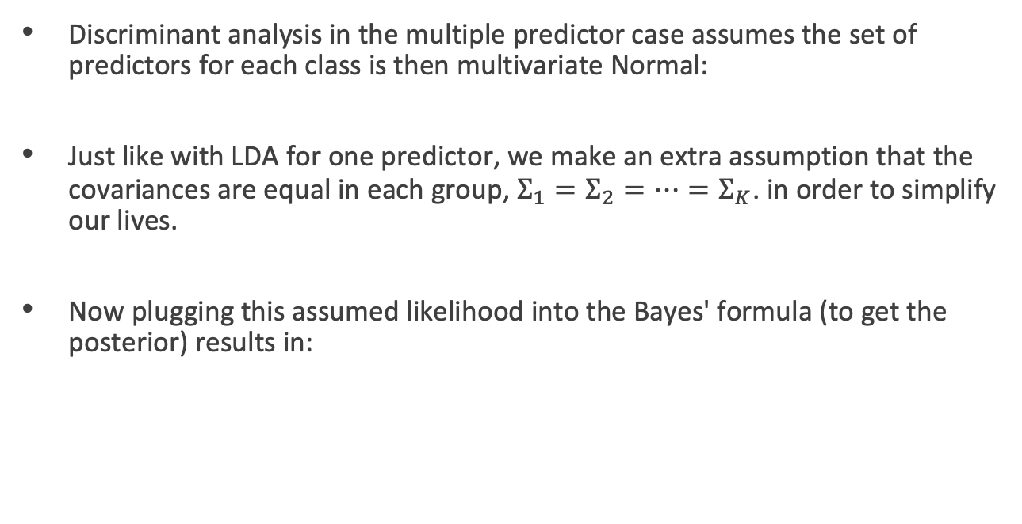
LDA when p > 1
Discriminant analysis in the multiple predictor case assumes the set of predictors for each class is then multivariate Normal:
Just like with LDA for one predictor, we make an extra assumption that the covariances are equal in each group, $Σ_{1}=Σ_{2}=…=Σ_{K}$. in order to simplify our lives.
Now plugging this assumed likelihood into the Bayes' formula (to get the posterior) results in:

Slide 21
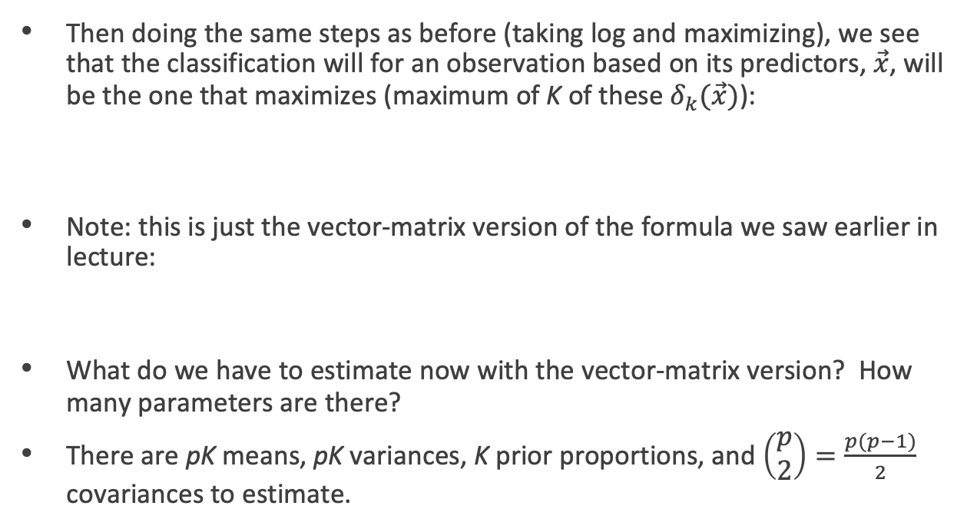
LDA when p > 1 (cont.)
Then doing the same steps as before (taking log and maximizing), we see that the classification will for an observation based on its predictors, $\vec{x}$, will be the one that maximizes (maximum of K of these $δ_{k}(\vec{x})$):
Note: this is just the vector-matrix version of the formula we saw earlier in lecture:
What do we have to estimate now with the vector-matrix version? How many parameters are there?
There are pK means, pK variances, K prior proportions, and $\left(\begin{matrix}p \\ 2\end{matrix}\right)=\frac{p(p−1)}{2}$ covariances to estimate.

Slide 22
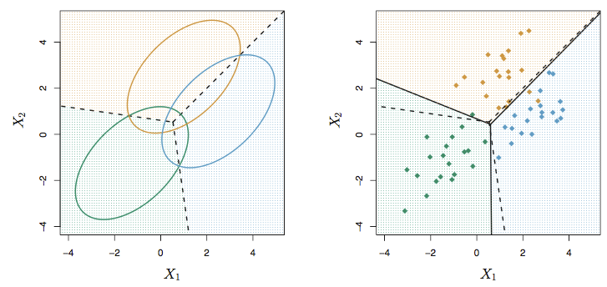
LDA when K > 2
The linear discriminant nature of LDA still holds not only when p > 1, but also when K > 2 for that matter as well. A picture can be very illustrative:

Slide 23
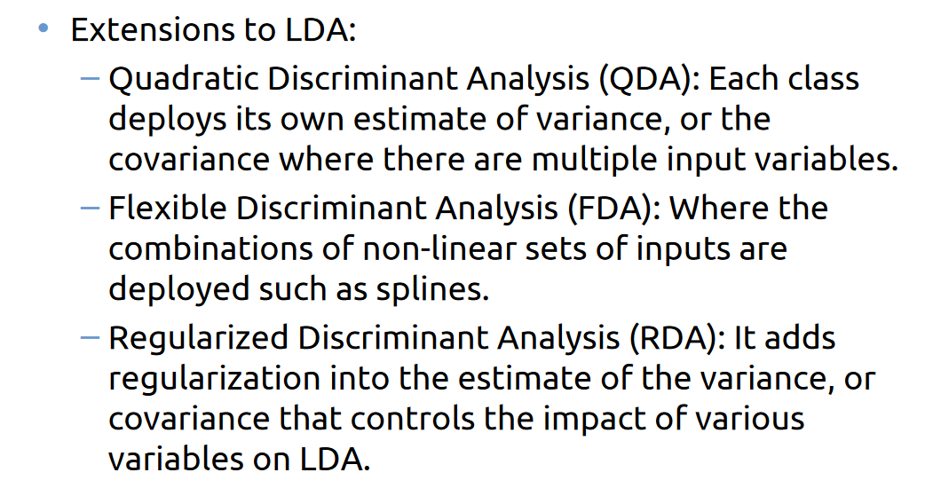
Extensions to LDA

Slide 24
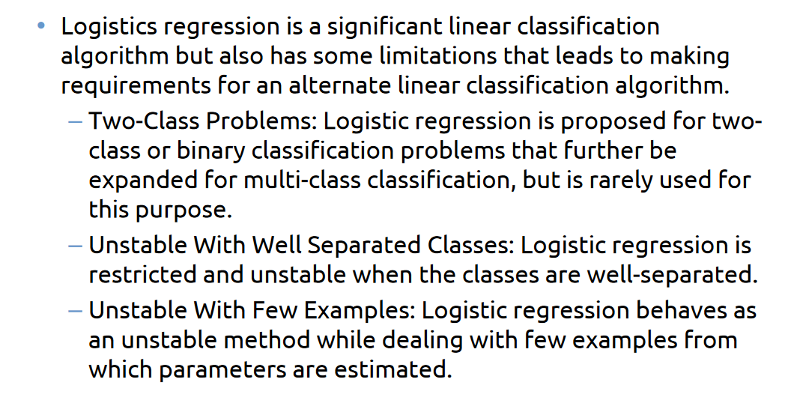
Limitations of Logistics Regression

Slide 25
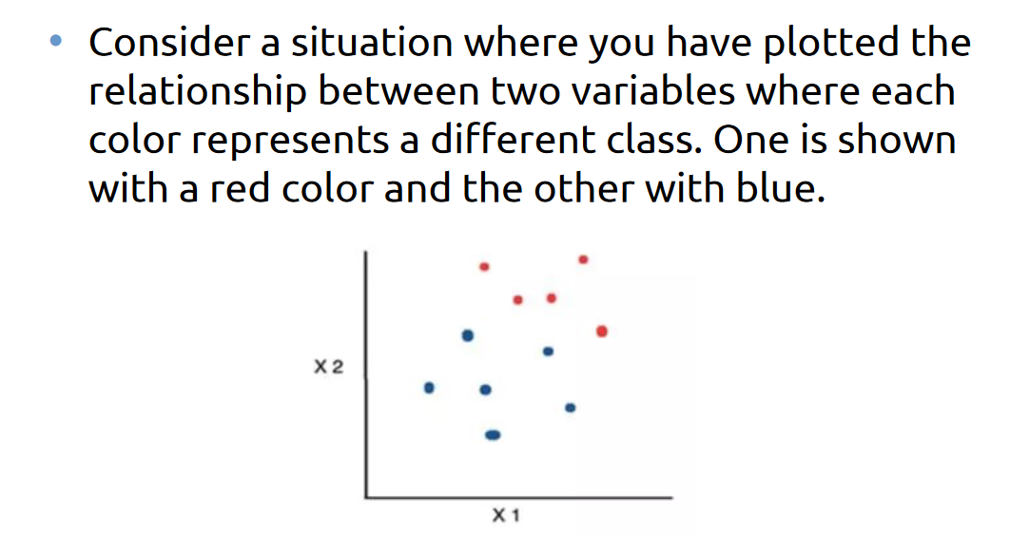
Practical Approach to an LDA

Slide 26
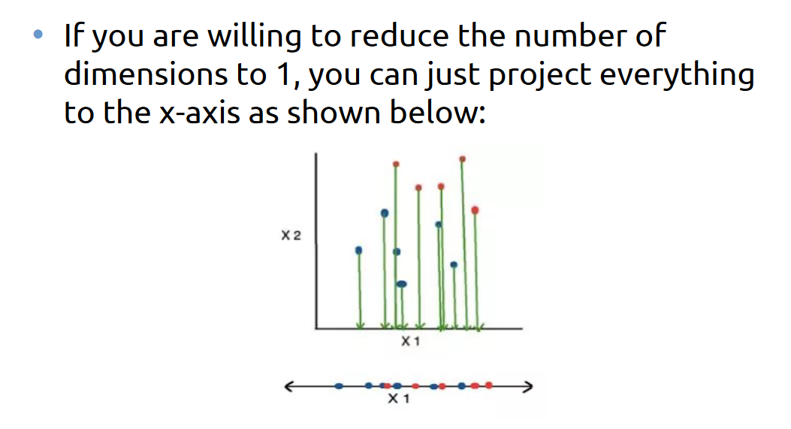
Practical Approach to an LDA

Slide 27
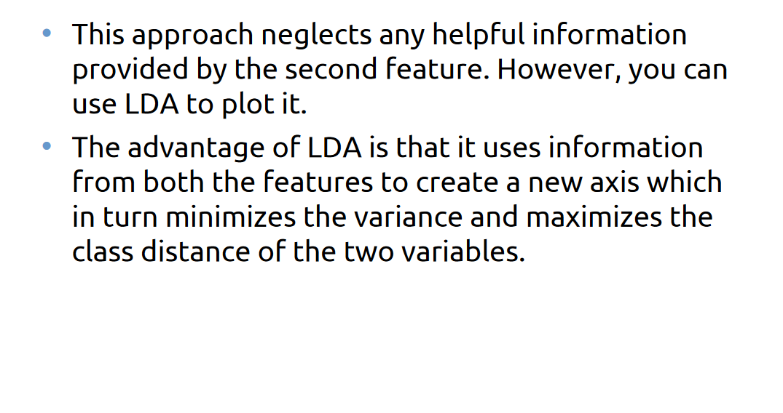
Practical Approach to an LDA

Slide 28
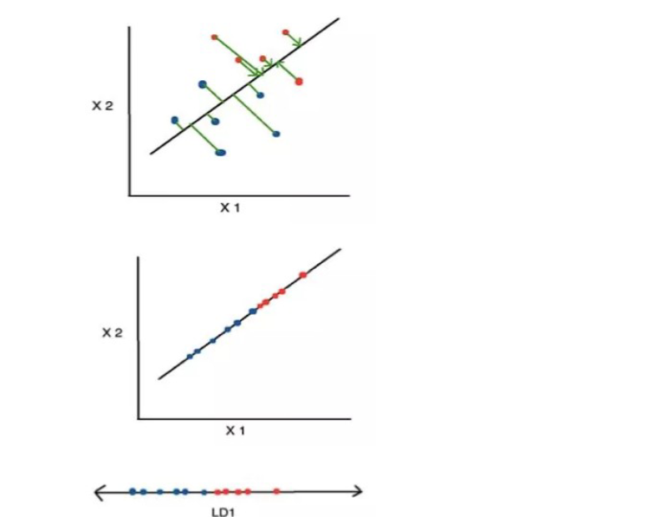
Practical Approach to an LDA

Slide 29
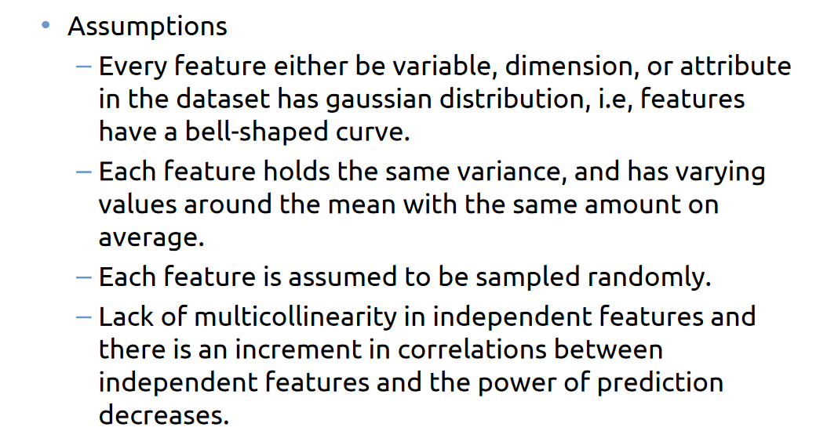
How does LDA works?

Slide 30
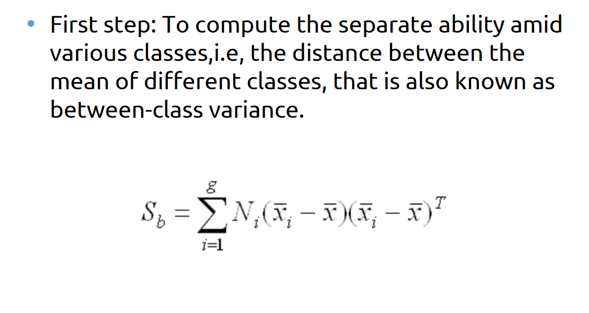
How does LDA works?

Slide 31
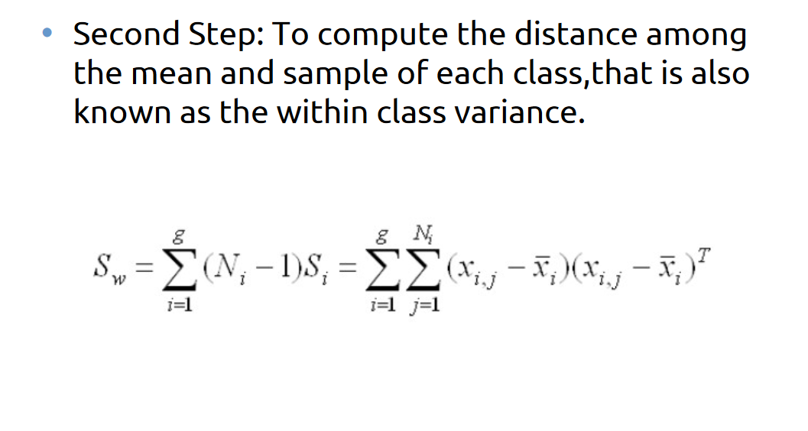
How does LDA works?

Slide 32
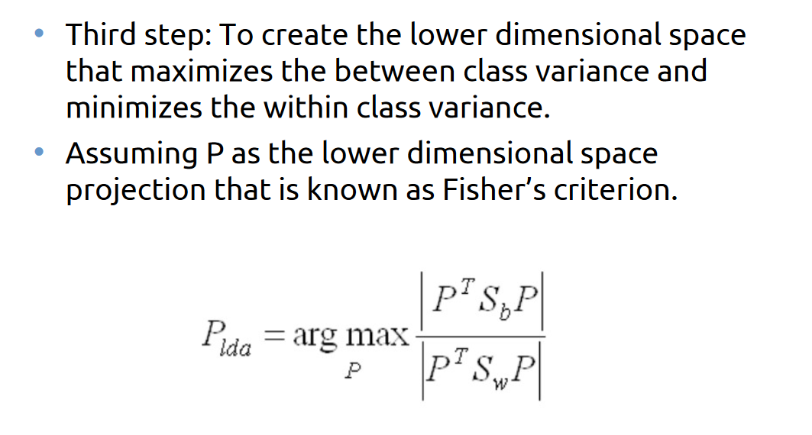
How does LDA works?

Slide 33
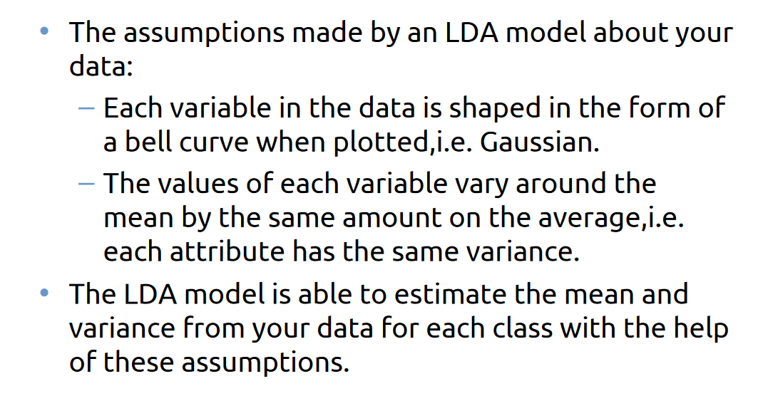
How do LDA models learn?

Slide 34
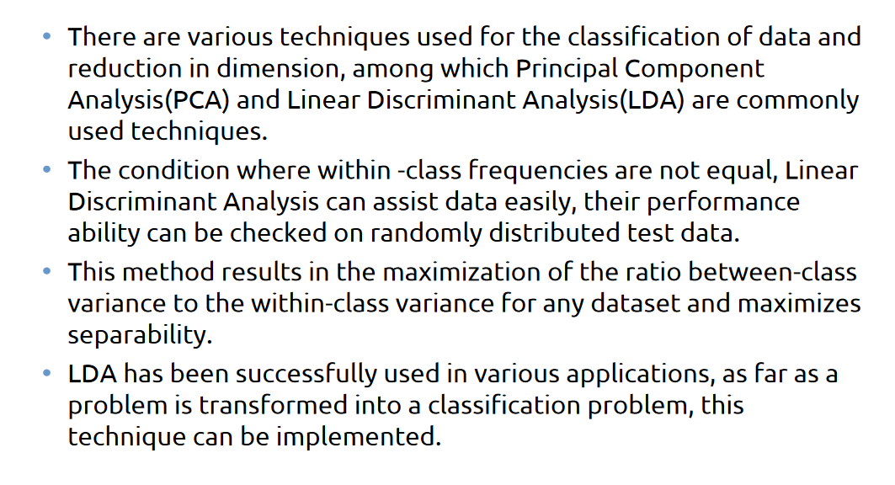
Applications

Slide 35
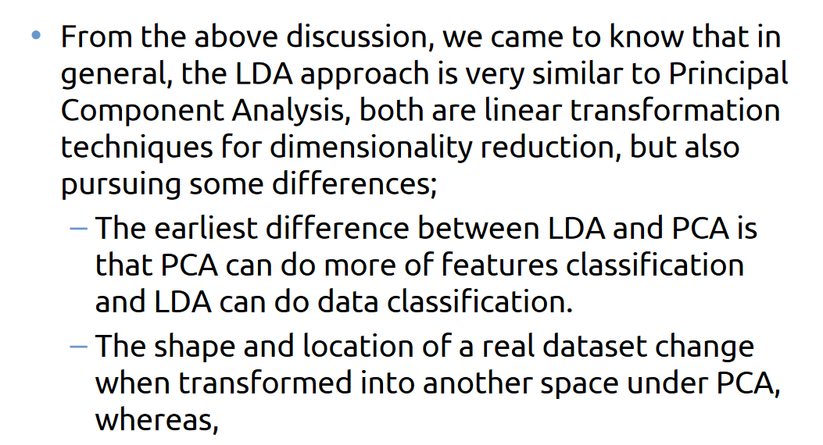
LDA vs. PDA

Slide 36
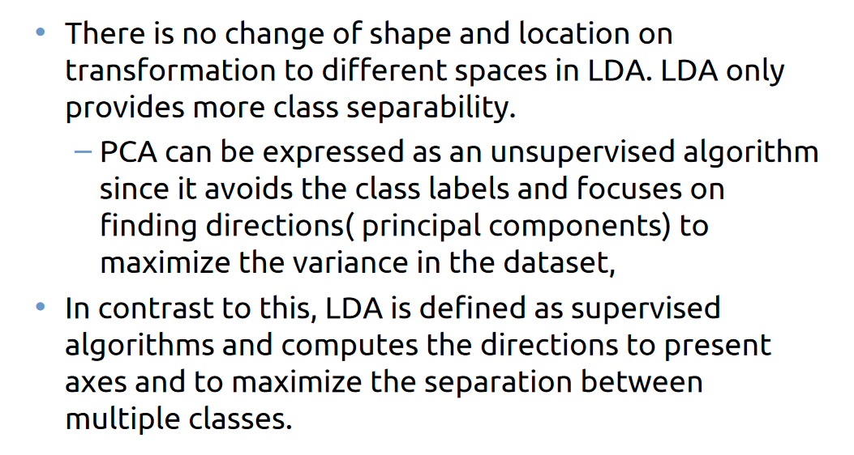
LDA vs. PDA

Slide 37
Quadratic Discriminant Analysis (QDA)
A generalization to linear discriminant analysis is quadratic discriminant analysis (QDA).
Why do you suppose the choice in name?
The implementation is just a slight variation on LDA. Instead of assuming the covariances of the MVN distributions within classes are equal, we instead allow them to be different.
This relaxation of an assumption completely changes the picture...

Slide 38
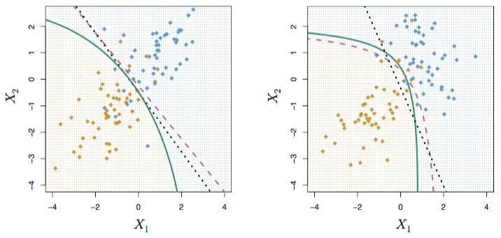
QDA in a picture
QDA in a picture
A picture can be very illustrative:

Slide 39
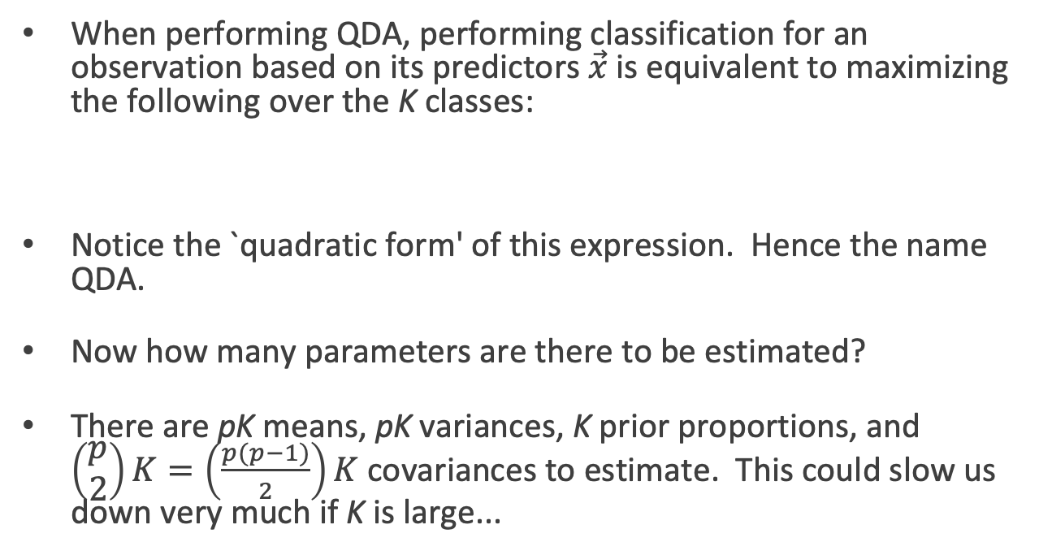
QDA (cont.)
When performing QDA, performing classification for an observation based on its predictors $\vec{x}$is equivalent to maximizing the following over the K classes:
Notice the `quadratic form' of this expression. Hence the name QDA.
Now how many parameters are there to be estimated?
There are pK means, pK variances, K prior proportions, and $\left(\begin{matrix}p \\ 2\end{matrix}\right)K=\left(\frac{p(p−1)}{2}\right)K$ covariances to estimate. This could slow us down very much if K is large...

Slide 40
QDA vs. LDA
So both QDA and LDA take a similar approach to solving this classification problem: they use Bayes' rule to flip the conditional probability statement and assume observations within each class are multivariate Normal (MVN) distributed.
QDA differs in that it does not assume a common covariance across classes for these MVNs.

Slide 41
QDA vs. LDA (cont.)
So, when should QDA be used over LDA? LDA over QDA?
The extra covariance parameters that need to be estimated in QDA not only slow us down, but also allow for another opportunity for overfitting.
Thus if your training set is small, LDA should perform better for out-of-sample prediction, aka, predicting future observations

